Slide 1

Video #5
HARDWARE - 4
BEGINNER TO EXPERT GUARANTEED
ULTIMATE IT COURSE
ACCESS NETWORKING COURSE PLAYLIST LINK IN DESCRIPTION
SUBSCRIBE!!!

Slide 2
Answers
1. Whats is AMD ryzen 5 ? (RAM/Processor/Motherboard)
2. Identify the generation of Processor Intel i7 9440 ? (5th/8th/10th/9th)
3. Voltage of Yellow wire in SMPS ? (+12v)
4. How we pervent heat generated by working Microprocessor ?
(By installing Heatsink using thermal grease for absorbing the heat and fan for preventing it out the cabinet)
5. Work of North Bridge & South Bridge in Motherboard ?
(North Bridge is responsible for interconnection of Components
South Bridge is responsible for interconnection of Peripherals)
Solve all question and comment down answers...

Slide 3
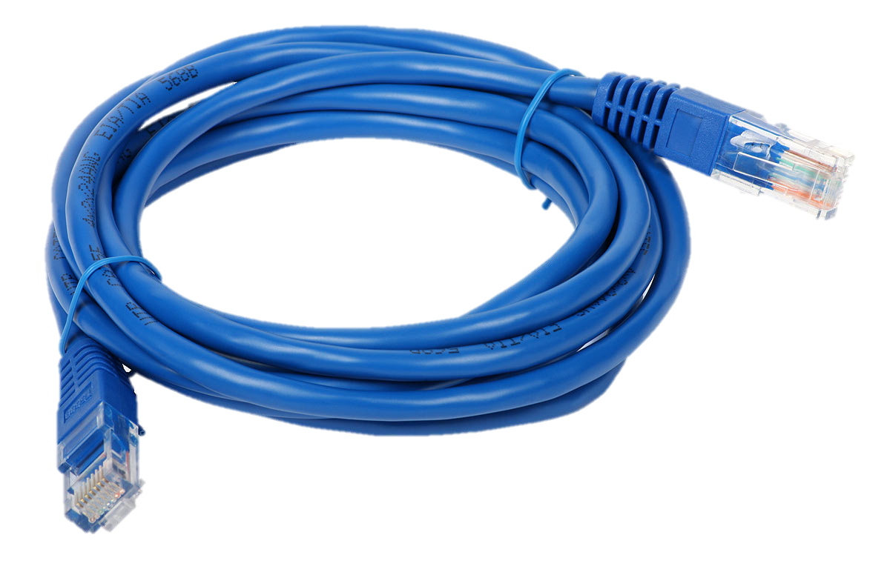
What is a Cable?
An electrical cable is an assembly of one or more wires running side by side or bundled, which is used to carry electric current. A cable assembly is the composition of one or more electrical cables and their corresponding connectors.

Slide 4
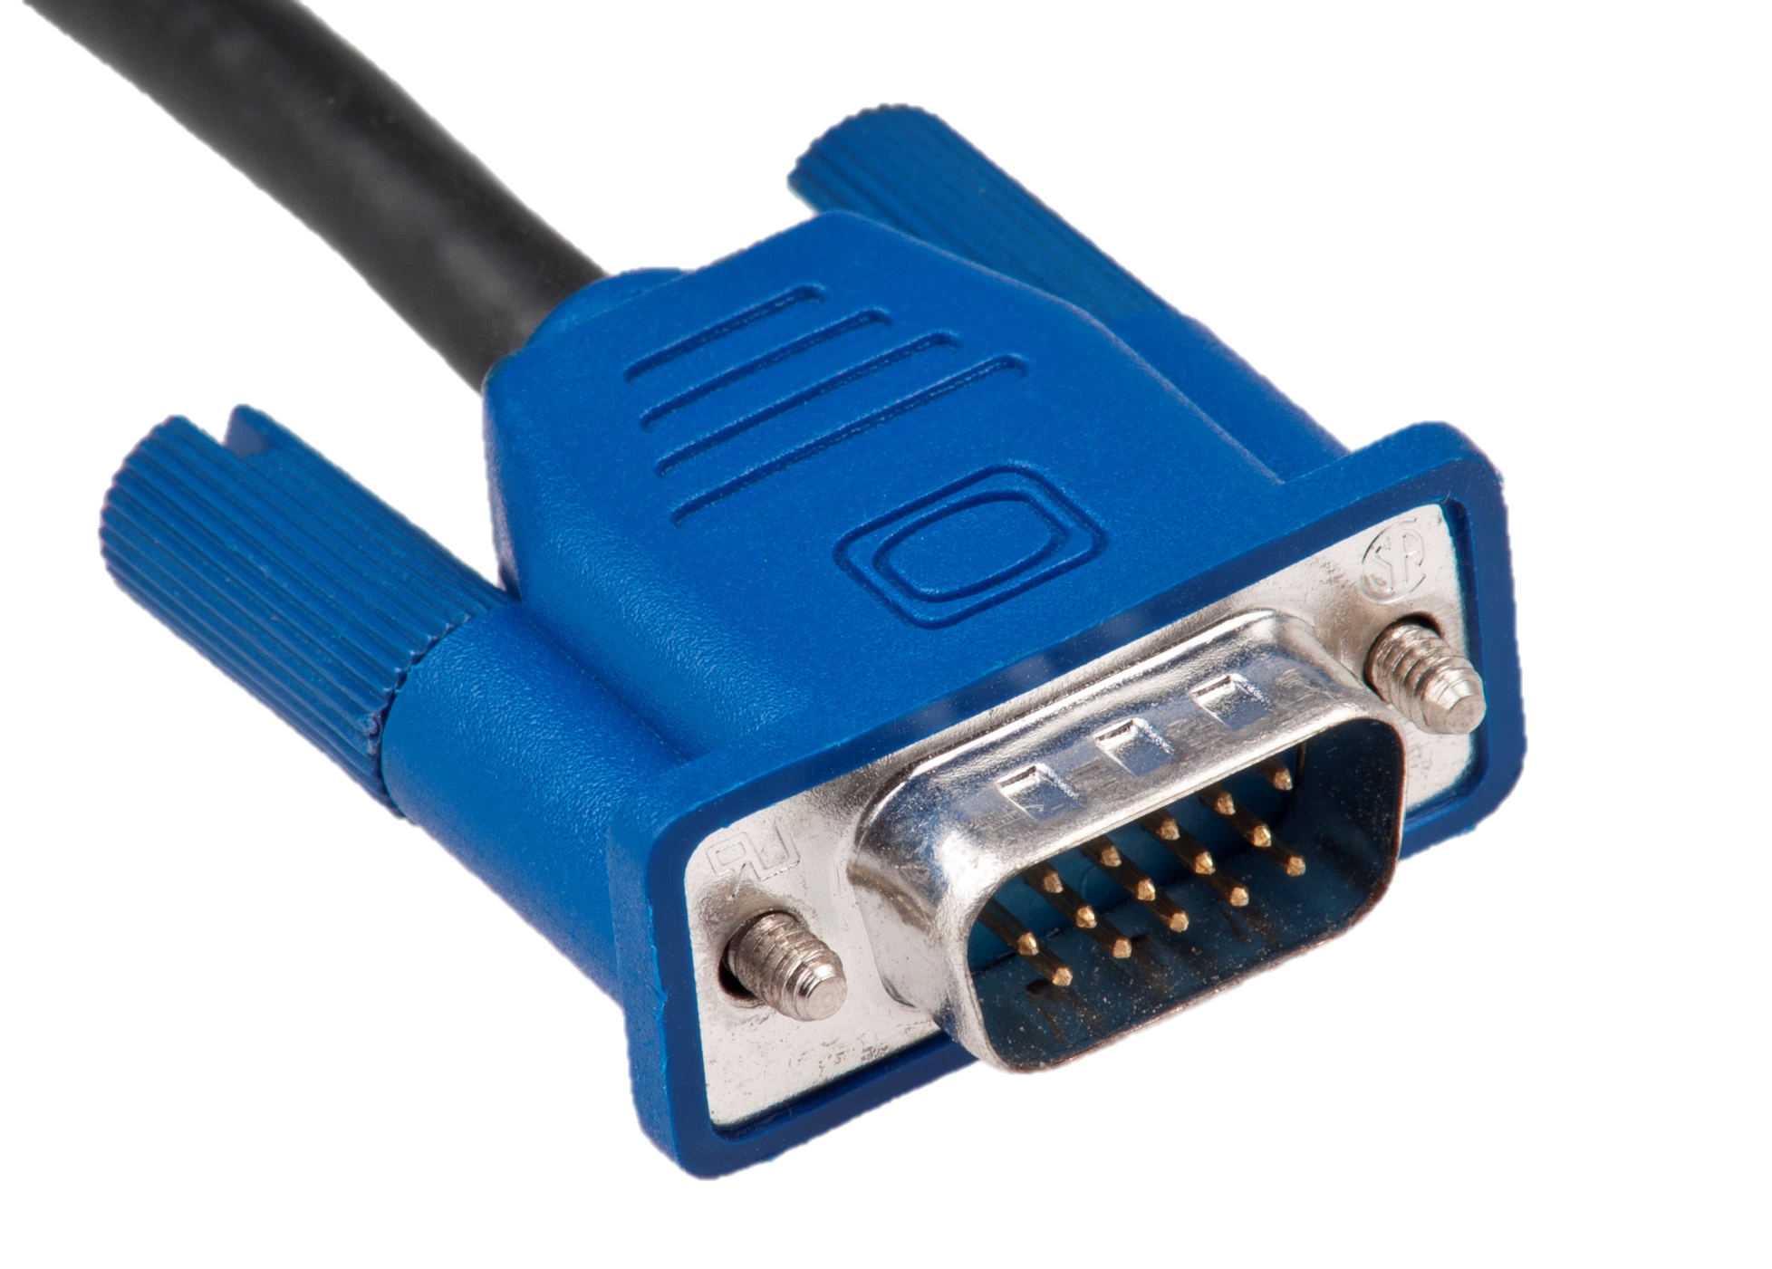
What is a Connector?
A Connector is generally a specific Interface which is used to connect a device physically with a computer systemm with staibility
It is used to install the Cable or interface of external media or devices to a computer system.

Slide 5
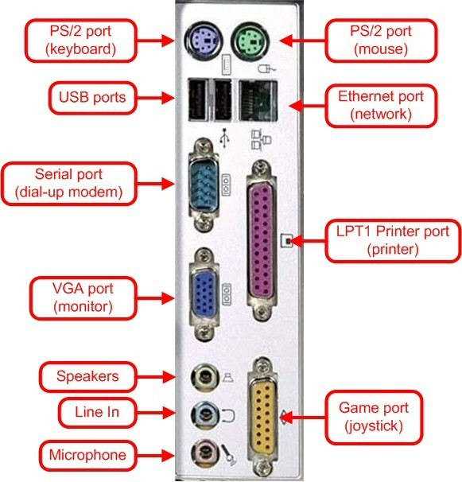
What is a Port?
A port is generally a specific place for being physically connected to some other device, usually with a socket or plug which we call Connectors
It is used to install the connector or interface of external media or devices to a computer system.

Slide 6
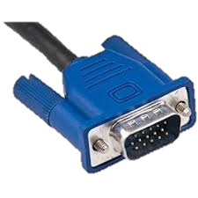
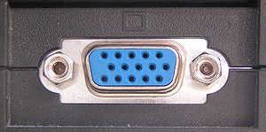
1. VGA Cable
VGA stands for Video Graphics Array. A VGA cable is a device used to transfer video signals.
VGA Port
Connects monitor to a computer's video card.
It has 15 holes.
Can transmit with resolution of 640x480
Similar to the serial port connector. However, serial port connector has pins, VGA port has holes.

Slide 7
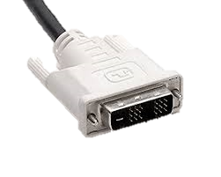
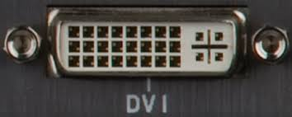
2. DVI Cable
DVI stands for Digital Visual Interface. The digital interface is used to connect a video source, such as a video display controller, to a display device, such as a computer monitor.
DVI Port
Connects Flat panel LCD & CRT monitor to
the computer's high-end video video cards.
Very popular among video card manufacturers
Transmission resolution 2560x1600

Slide 8
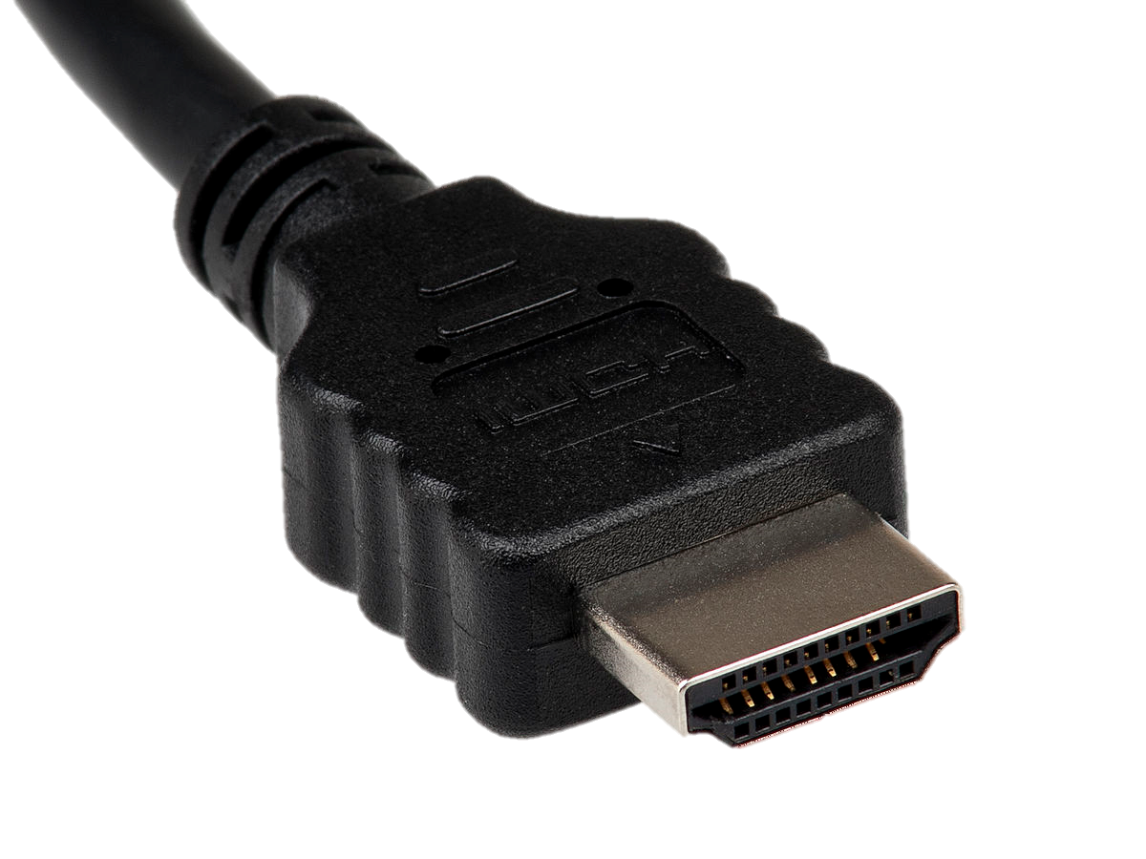
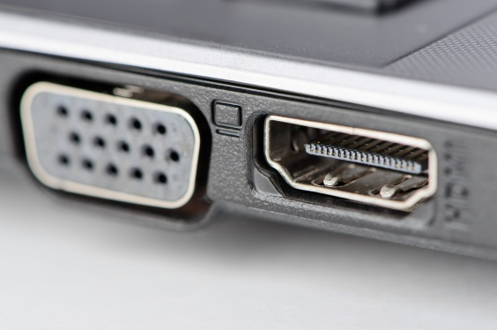
3. HDMI Cable
HDMI stands for High-Definition Multimedia Interface, a standard for simultaneously transmitting digital video and audio from a source, such as a computer or TV cable box, to a computer monitor, TV or projector.
HDMI Port
It can transmit both HD audio and Video at a time 2560x1600
Used for high data transfer bandwidth
Uses in Gaming Consoles like Play station and HDTV

Slide 9
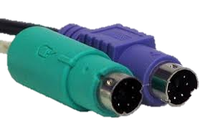
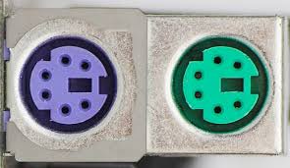
4. PS2 Cable
The PS/2 (Personal System/2) also referred to as the mouse cable or keyboard cable, was developed by IBM. It is used to connect a computer mouse or keyboard to an IBM compatible computer. The PS/2 port is a mini DIN plug containing six pins
PS2 Port
Used for old computer keyboard and mouse
Also called mouse port
Green for Mouse Purple for Keyboard

Slide 10
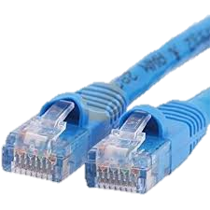
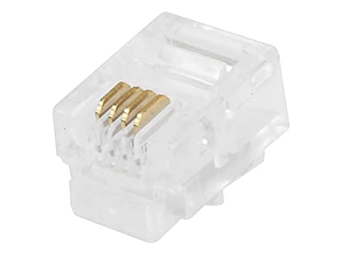
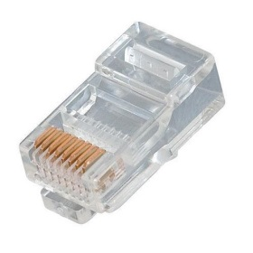
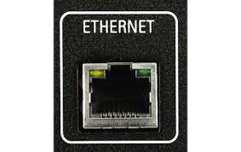
5. Twisted Pair Cable
Twisted-pair cable is a type of cabling that is used for telephone communications and most modern Ethernet networks. A pair of wires forms a circuit that can transmit data. The pairs are twisted to provide protection against crosstalk, the noise generated by adjacent pairs having RJ-11 & RJ-45 Jacks.
Two Types :-
STP (Shielded Twisted Pair Cable)
UTP (Unshielded Twisted Pair Cable)
Ethernet Port
Connects to a network and high speed Internet upto 100baseT.
Known as RJ-45 Port which use RJ-45 Jack as Interface
This port resides on an Ethernet Card.

Slide 11
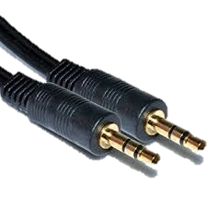

6. Mini Plug Cables
A Mini Plug is a 3.5mm male connector found on computer headphone, headset, microphone, and speakers, which connects to the computer's sound card.
Mini Port
Connects Microphone, Headphone & Speakers.
Used 3.5mm jack to connect devices in it.

Slide 12
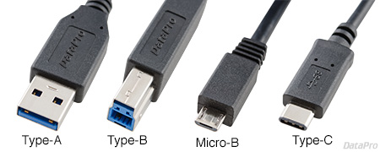
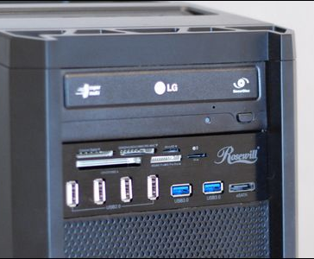
7. USB Cable
A USB port is a standard cable connection interface for personal computers and consumer electronics devices. USB stands for Universal Serial Bus, an industry standard for short-distance digital data communications.
USB Port
It can connect all kinds of external USB devices such as external hard disk, printer, scanner, mouse, keyboard, etc.
Most of the computers provide two USB ports as minimum.
Data travels with different speeds depend on ver.
USB compliant devices can get power from a USB port.

Slide 13
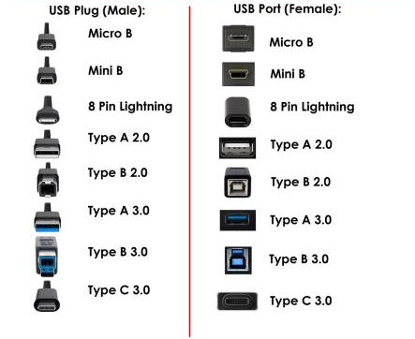

Slide 14
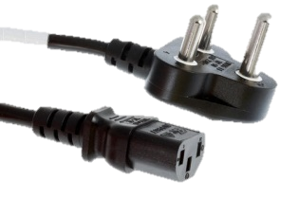
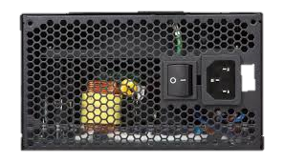
8. Power Cord
A power cord, line cord, or mains cable is an electrical cable that temporarily connects an appliance to the mains electricity supply via a wall socket or extension cord.
Kettle Input
Three-pronged plug.
Connects to the computer's power cable that plugs into a power bar or wall socket.

Slide 15
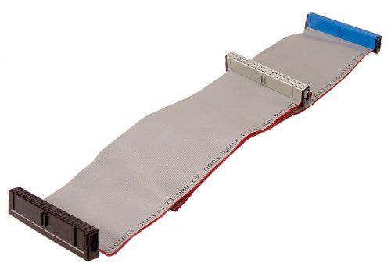
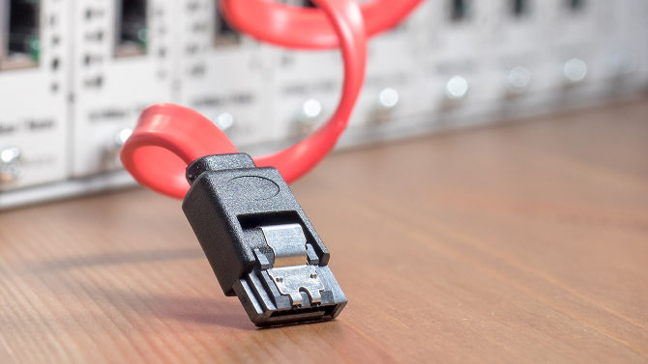
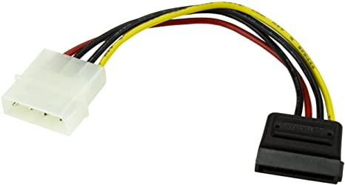
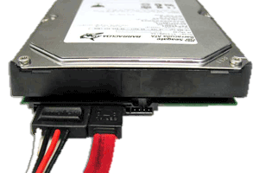
9. HDD Wires
SATA Cable
IDE Cable
Molex Cable
These Cables are used to Connect Hard Disk Drive to Computer

Slide 16
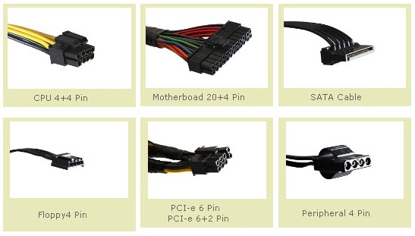
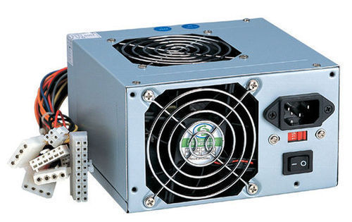
10. SMPS Wires
CPU Power
ATX Power
SATA Power
Floppy Power
PCI Power
ODD Power

Slide 17
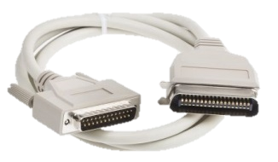
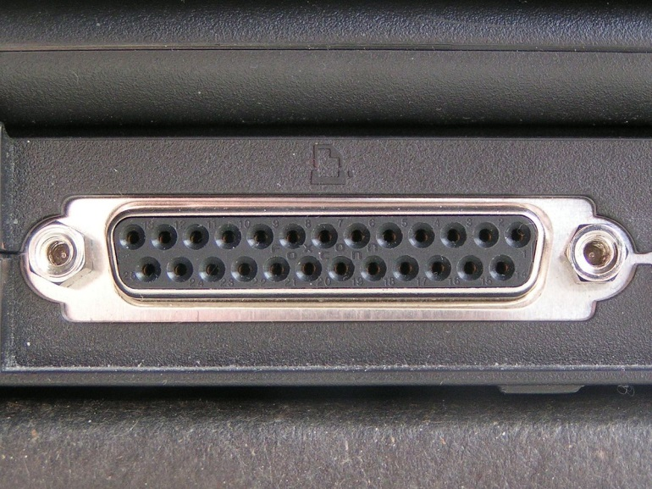
11. Parallel Cable
Parallel cables have mostly given way to serial cables, where data is transferred one bit after another.
Parallel Port
Used for scanners and printers
Also called printer port
25 pin model

Slide 18
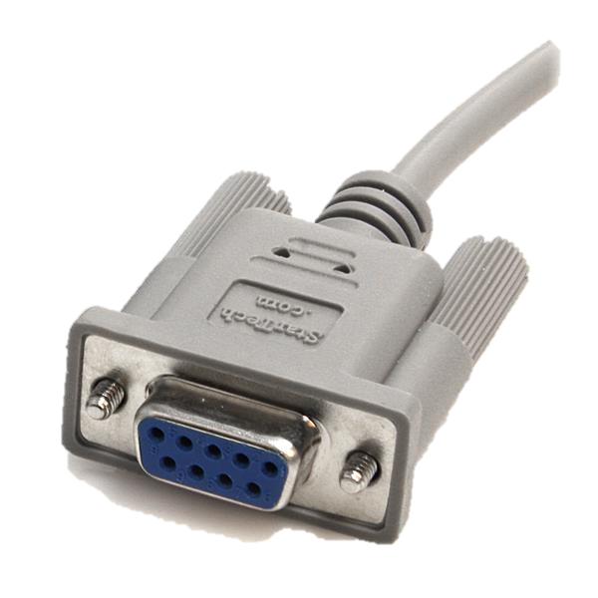
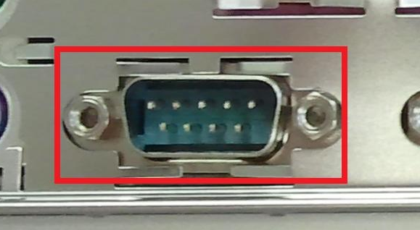
12. Serial Cable
A serial cable is a cable used to transfer information between two devices using a serial communication protocol.
Serial Port
Used for external modems and older computer mouse
Two versions: 9 pin, 25 pin model
Also uses in Printers and Scanners
Data travels at 115 kilobits per second

Slide 19
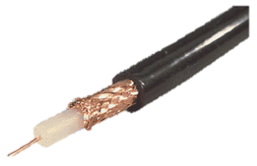
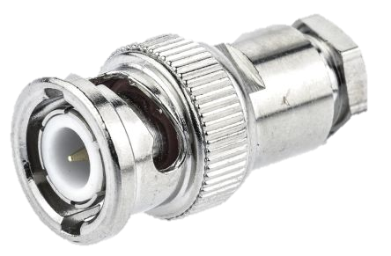
13. Coaxial Cable
Coaxial cable is commonly used by cable operators, telephone companies, and internet providers around the world to convey data, video, and voice communications to customers. It has also been used extensively within homes.
BNC Connector
Bayonet Neill–Concelman BNC connector is a series of connectors used for connecting thinnet coaxial cabling to various networking components.

Slide 20
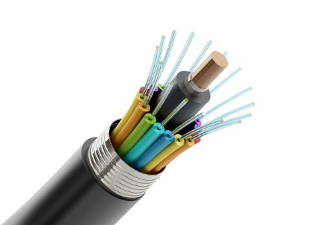
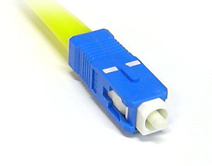
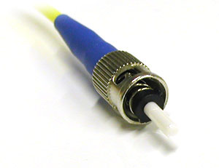
14. Optic Fibre Cable
Fibre optics is a modern technology used mostly in the telecommunication industry to transmit information digitally as pulses of light through strands of fibre made of glass.Also known as Optical fibres, these strands are about the diameter of a human hair follicle. When bundled into an optical fibre cable, they can transmit data in volumes faster than other mediums over really long distances.
Subscriber Connector SC
This Connector is for structural cabling it is used for high speed
And for single mode fibre cabling
Straight Tip ST
This Connector is for structural cabling it is used for high speed
And for Multi mode fibre cabling

Slide 21
Questions:-
1. VGA is capable to transmit ? (Video/Audio/Data/Radio Signals)
2. Abbrevation of BNC ?
3. Meaning of 1000Base-T ?
4. Which is Apple iphone charger Connector ?
5. Why HDMI is better then DVI & VGA ?
Solve all question and comment down answers...

